Slide 1


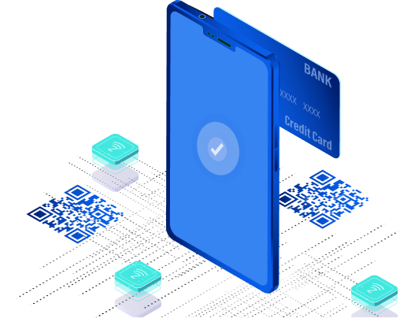
Mobile App Overview
Live Product Demonstration (Powered by MineSec SoftPOS Suite)

Slide 2




PROGRESS SINCE LAST DEMO
Core Payment Foundation Completed • End-to-end payment flows stabilized (Purchase, Void, Refund) • Integration with Gateway, SoftPOS & DCS (Acquirer) aligned
User Experience Improvements • Enhanced UI/UX across key screens
• Faster navigation and clearer transaction visibility
Merchant Operational Features Introduced • Staff access with restricted permissions
• Improved transaction tracking and reporting
Performance & Stability Enhancements • Optimized app performance and response time • Improved error handling and system reliability
Preparation for Production Release • Ongoing settlement validation & backend alignment
• Final testing and security hardening in progress
“From foundation → to a production-ready payment solution”

Slide 3
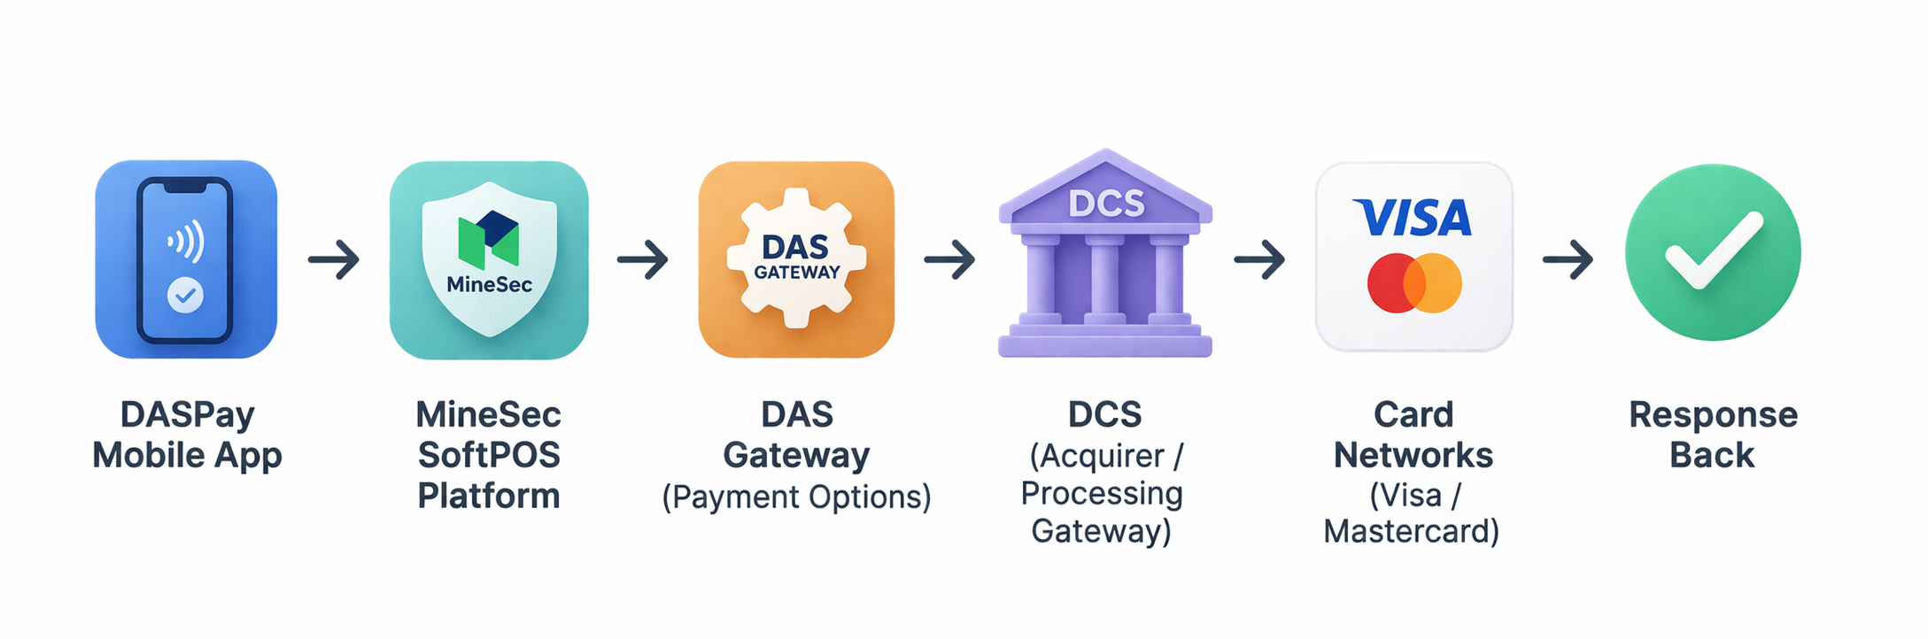
PAYMENT FLOW ARCHITECTURE (DASPay Ecosystem)
MID / TID Mapping Flow
Configured at DCS level
Linked in MineSec (Terminal + Merchant setup)
Routed via DAS Gateway per transaction
SDK Encryption → MineSec Core → Gateway Validation → Acquirer Processing

Slide 4

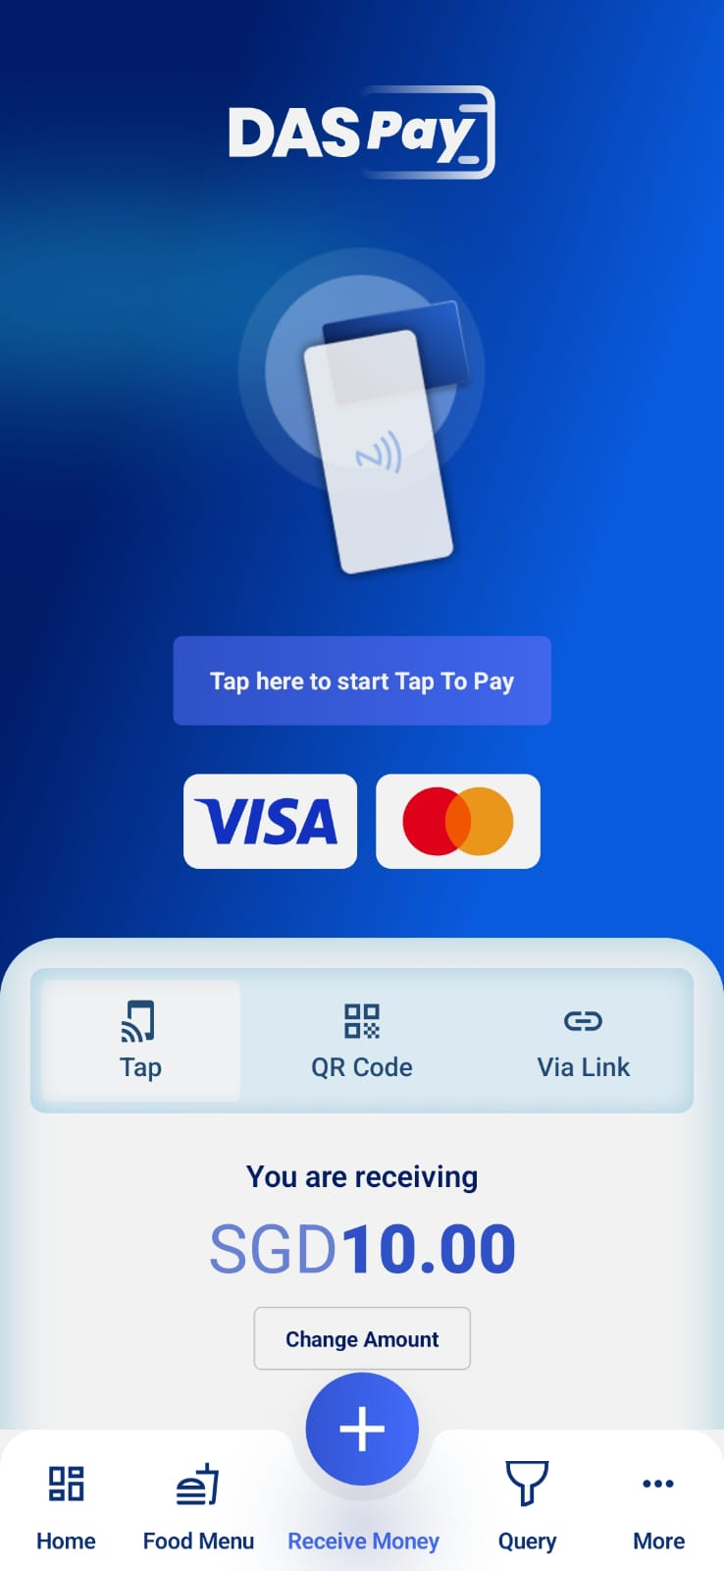
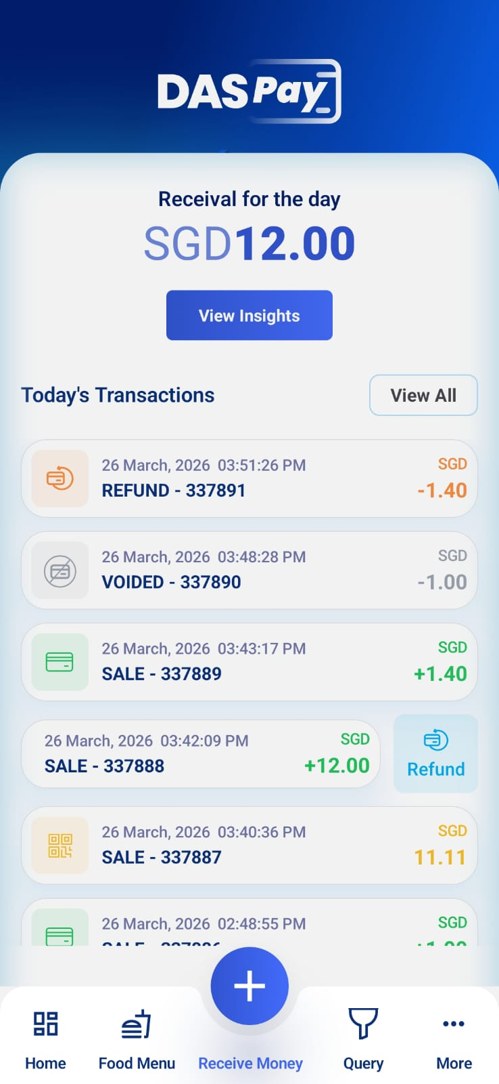
CORE PAYMENT FLOWS
Purchase Flow (Tap / QR / Link) • Seamless payment acceptance across multiple methods
Void Transaction • Cancel transactions before settlement
• Immediate reversal with status update
Refund Handling • Full refund support for successful transactions (after settlement)
• Includes receipt and tracking
Reliable and complete payment lifecycle management

Slide 5
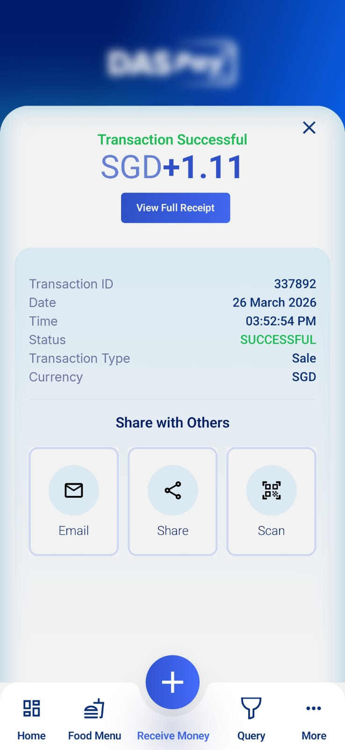
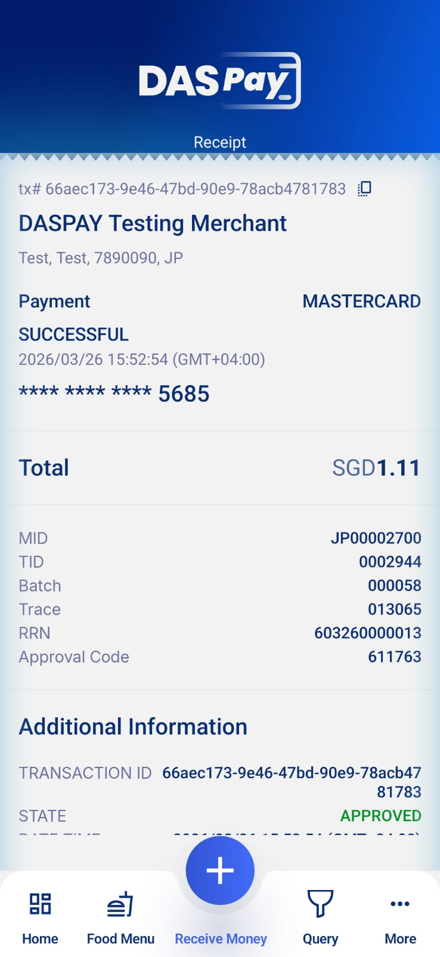
TRANSACTION DETAILS & RECEIPT HANDLING
Detailed Transaction View • Amount, status, reference, approval code
• Clear breakdown for merchant visibility
Receipt Management • Generate digital receipts instantly
• Options to share, email, or scan QR
Improved Transparency • Better tracking for both merchant and customer
Improves trust and reduces support queries

Slide 6
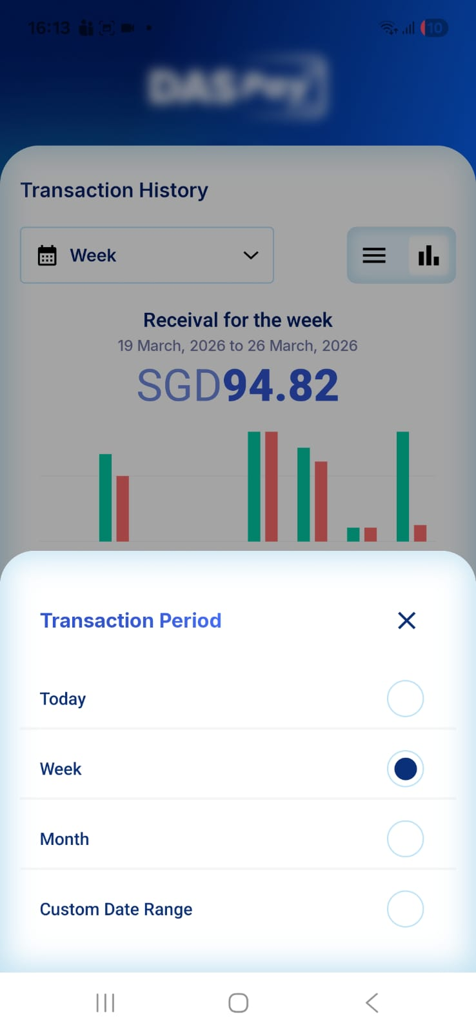
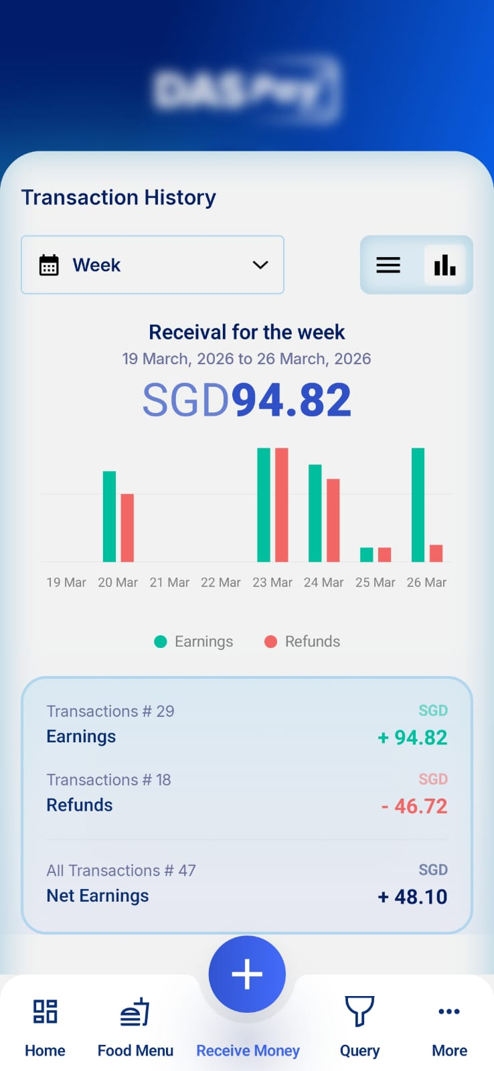
DASHBOARD OPTIMISATION
Improved Sales Overview • Clear visibility of earnings vs refunds
Optimised Chart Performance • Faster loading and smoother interactions
Better Insights • Helps merchants quickly understand daily performance
Data-driven decision making made simple

Slide 7
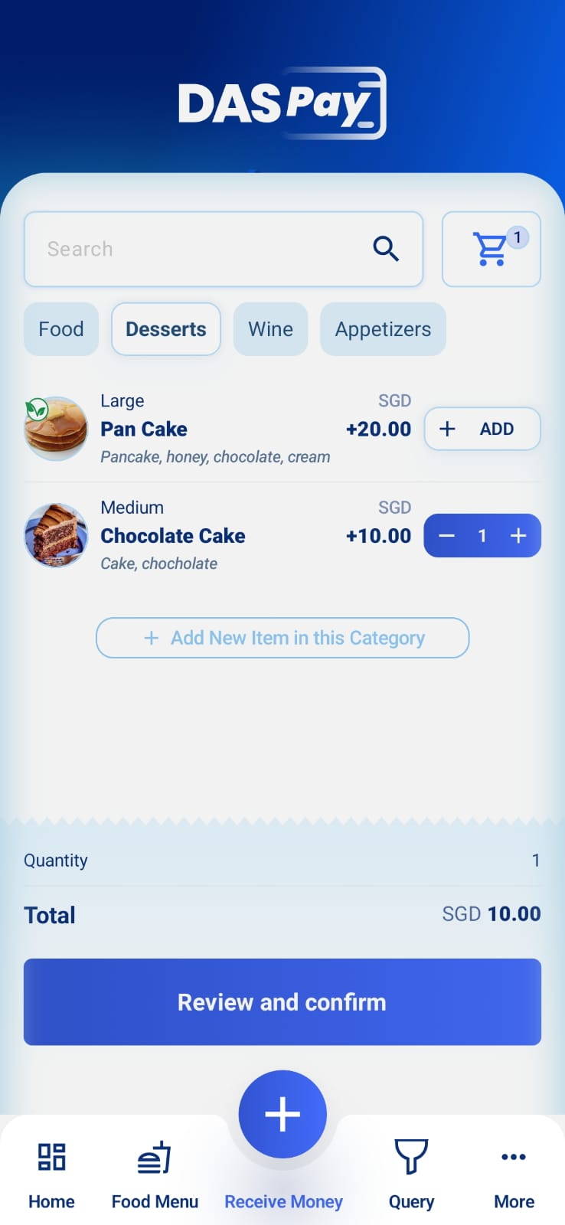
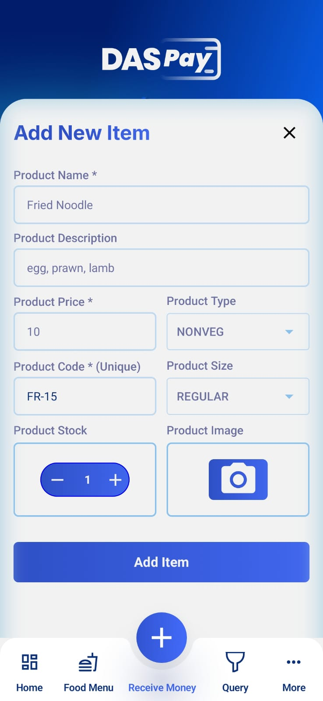
CATALOG PRODUCT MANAGEMENT
Create & Manage Products from App • Add / Edit items directly in mobile app
• Upload Item Photo from app
Real-Time Sync with Gateway • Changes reflect instantly
Flexible Usage • Ideal for merchants with dynamic pricing or menus
Reduces dependency on back-office systems

Slide 8
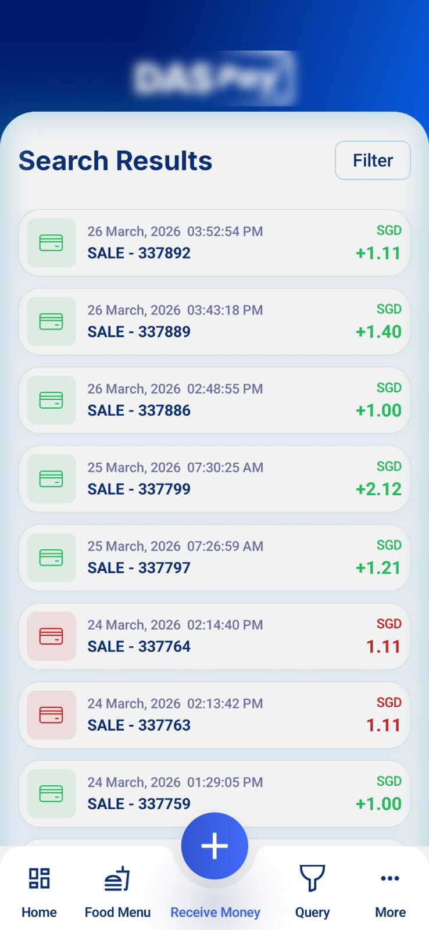
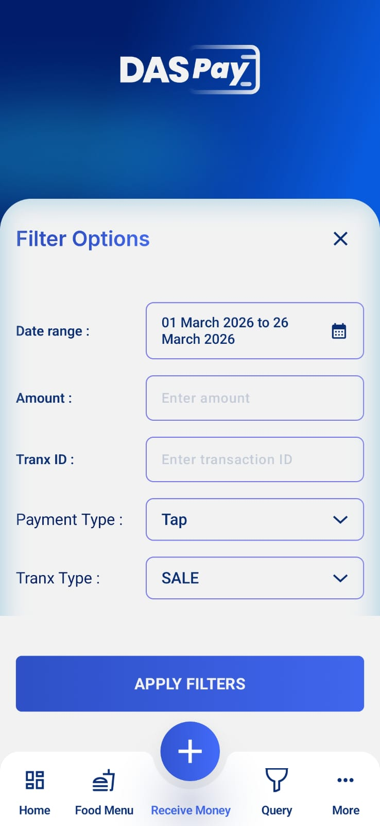
SEARCH & QUERY SCREEN
Advanced Transaction Search • Search by date, amount, reference, or status
Quick Access to Records • Faster troubleshooting and tracking
Improved Navigation • Designed for operational efficiency
Saves time for merchants and support teams

Slide 9
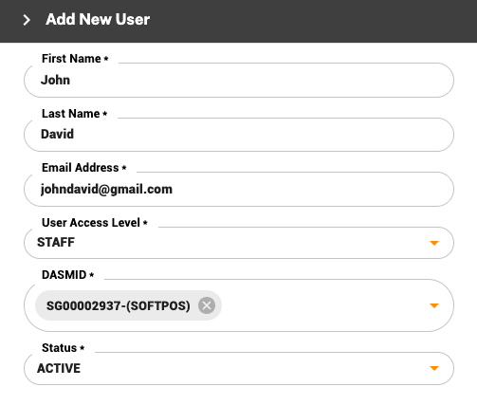
STAFF ACCESS ROLES & PERMISSIONS
Restricted Access Control • Staff can process transactions
Limited Visibility • Access only to today’s transactions
Secure Operations • Protects sensitive business data
Enables team usage without compromising control

Slide 10
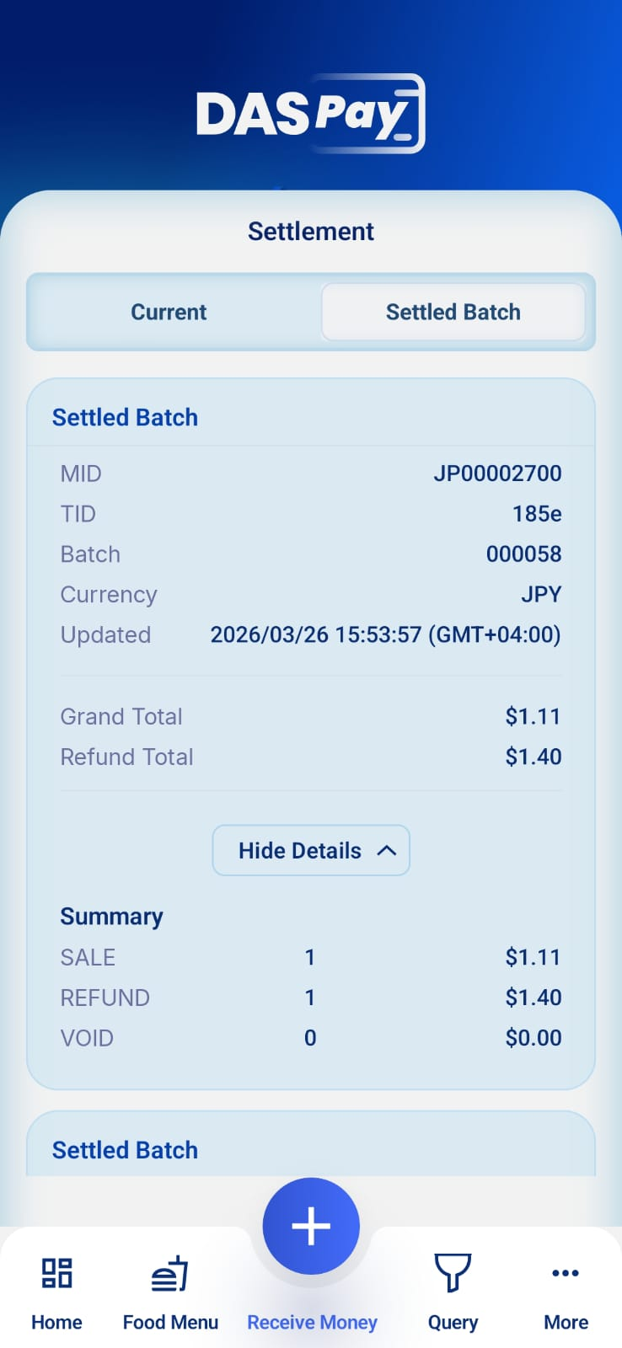
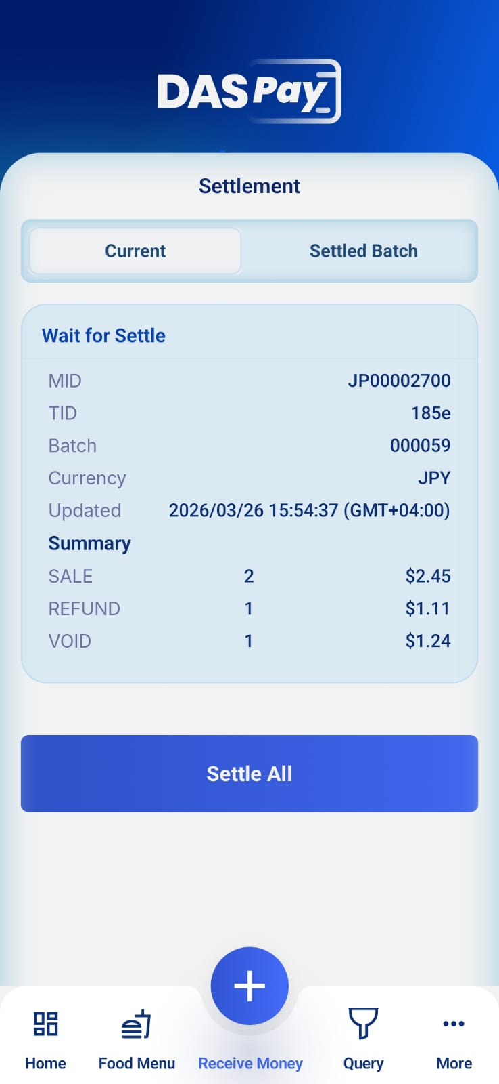
SETTLEMENT (Current Batch / Settled Batch)
Batch Visibility • Current Batch vs Settled Batch
Financial Summary per Batch • Sales, Refunds, Voids overview
Settlement Flow Integration • Aligned with acquirer processing
…

Slide 11


LIVE DEMO

Slide 12
WHAT THIS MEANS FOR BUSINESS
Faster payment processing Quick, seamless transactions with instant processing
Better visibility on transactions Clear view of sales, refunds, and transaction details
Reduced operational dependency Manage products and transactions directly from the app
Improved merchant experience Simple UI, fast actions, and easy receipt sharing
Ready for scalable rollout Ready to onboard and support growing merchant needs
DASPay is now moving from development → to real business impact

Slide 13


